Slide 1
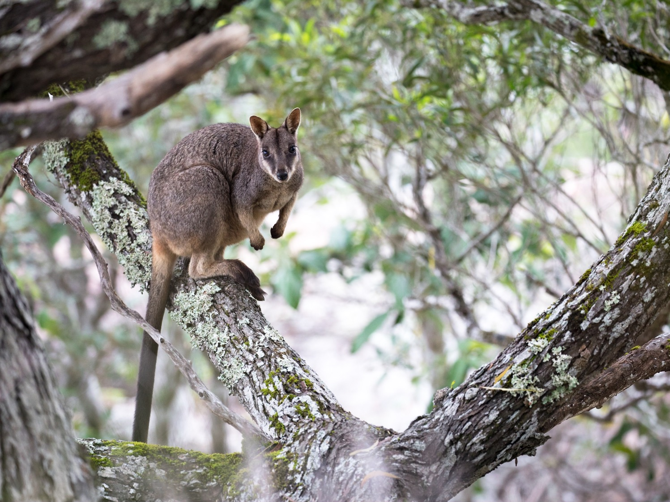
BIOL365: Marine and Terrestrial Ecology
Lecture 1: Practical introduction
James Dorey, Damien Esquerré, and Phil Byrne

Slide 2
Welcome to the BIOL365/971
Prac schedule
Week 1 - 22 Jul 2024 Introduction to the practical schedule of learning
Week 2 - 29 Jul 2024 Phylogenetic module
Week 3 - 05 Aug 2024 Phylogenetic module
Week 4 - 12 Aug 2024 Phylogenetic module
Week 5 - 19 Aug 2024 Phylogenetic module
Week 6 - 26 Aug 2024 Conservation Behaviour module
Week 7 - 02 Sep 2024 Quiz 1 (covering lectures 1–13). Conservation Behaviour module
Week 8 - 09 Sep 2024 Conservation Behaviour module
Week 9 - 16 Sep 2024 Conservation Behaviour module
Week 10 - 23 Sep 2024 Conservation Behaviour module — Elevator pitch
30 Sep 2024 Mid-Session Recess
Week 11 - 07 Oct 2024 Seminar delivery (group 1)
Week 12 - 14 Oct 2024 Seminar delivery (group 2)
Week 13 - 21 Oct 2024 Quiz 2 (covering lectures 14–26)

Slide 3
Phylogenetics module
Four-week module
Tied to an assessment task
You will present grant proposal (phylogeny + 1,200 words)
Worth 20%

Slide 4
What are phylogenies?
Phylogenies are a representation of [possible] evolutionary patterns
Genetic data
Amino acids
Morphology
Rooted or unrooted
outgroup

Slide 5
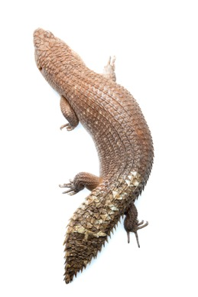
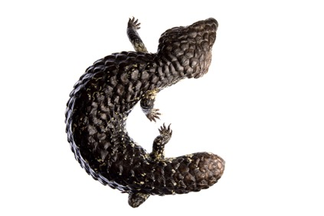
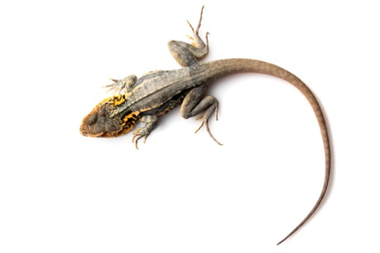
I’m an ecologist…
Evolution is ecology
Over a longer time period
Answer questions that you cannot with classical ecological inquiry

Slide 6
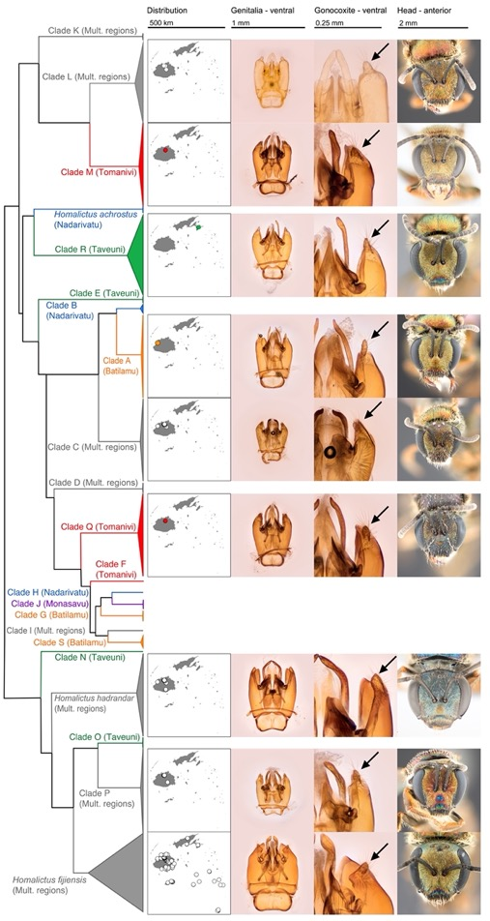
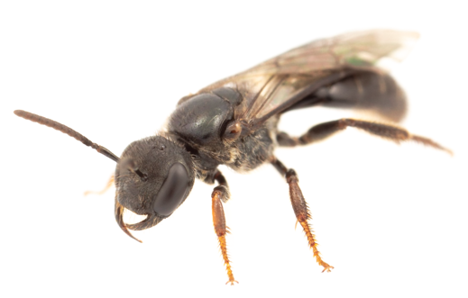
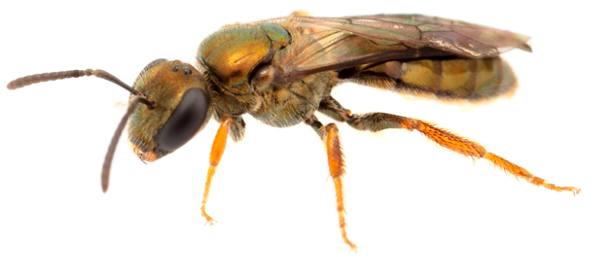
Example: Fijian Lasioglossum bees
Describe new species

Slide 7
Example: Fijian Lasioglossum bees
Infer traits & biogeography

Slide 8
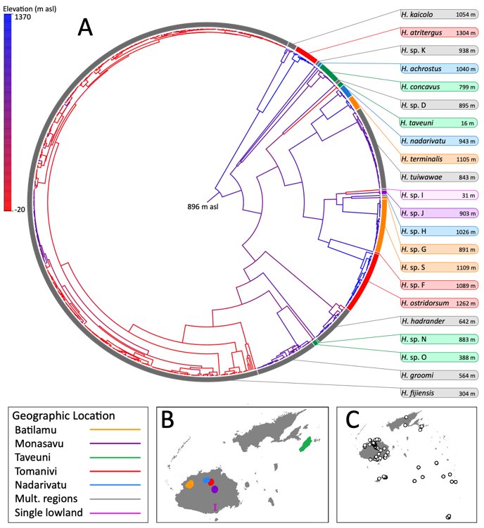
Example: Fijian Lasioglossum bees
Infer traits & biogeography

Slide 9
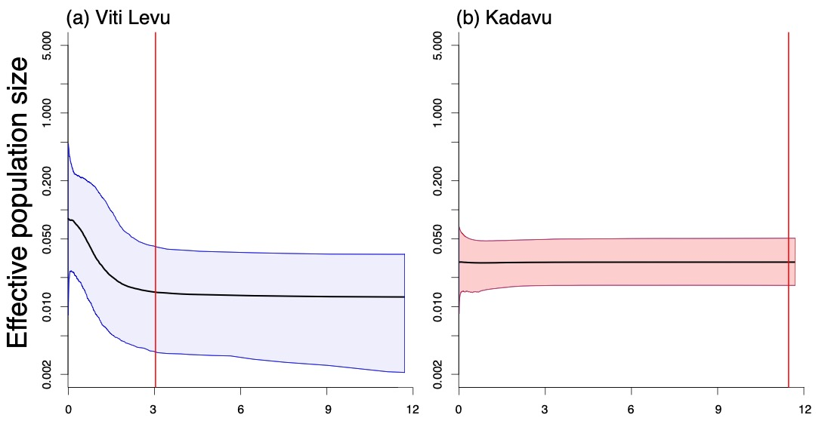

Example: Fijian Lasioglossum bees
Infer demographic changes

Slide 10
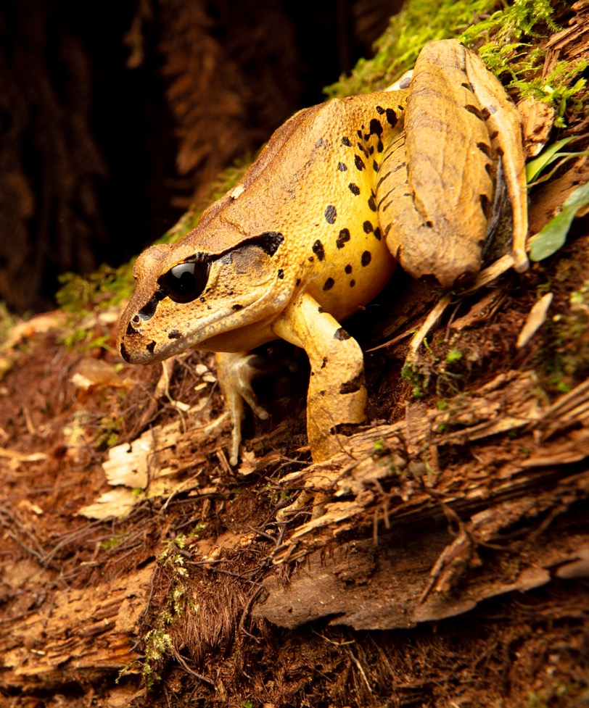
What will you be doing?
1. Activity: Address a macroevolutionary question
2. Aim: 2–3 pracs learning about phylogenetics in R
-3 Assessment: Apply this knowledge to your question in a Grant Proposal (20%)

Slide 11
Grant Proposal assessment
In two parts:
Preliminary phylogeny (5%)
Apply your R skills to answer a question
Grant proposal (15%)
Apply your writing skills to a grant

Slide 12
Grant Proposal assessment
What is a grant proposal?
Request project funds
Relevant in many fields
Requires:
Understanding priorities
Excellent writing
Evidence
Following guidelines
…

Slide 13
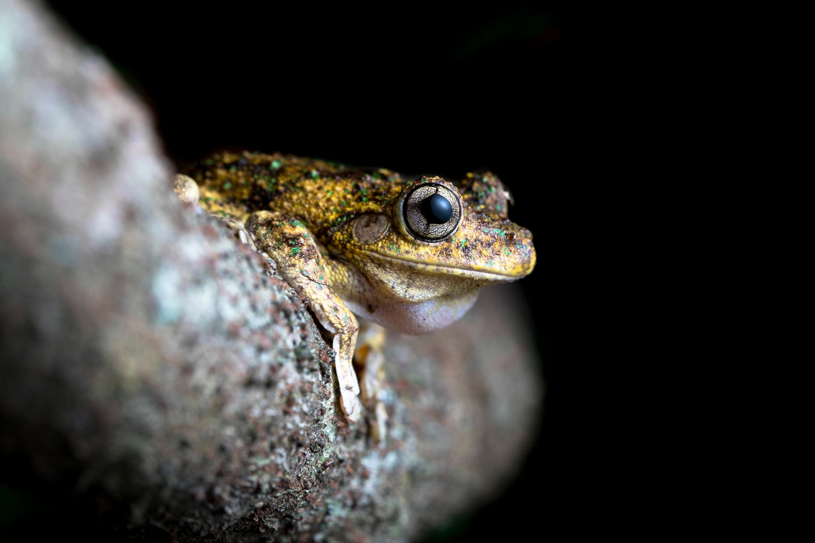
Grant Proposal assessment
A last word on R…
I don’t expect mastery
Errors are totally fine (we want to help you deal with them)
Not just phylogenetics or data manipulation — you are learning a language
It’s a tool

Slide 14
Conservation Behaviour module
Four-week module
Tied to an assessment task
You will present an elevator pitch to the class (5 minute talk)
Worth 20%

Slide 15
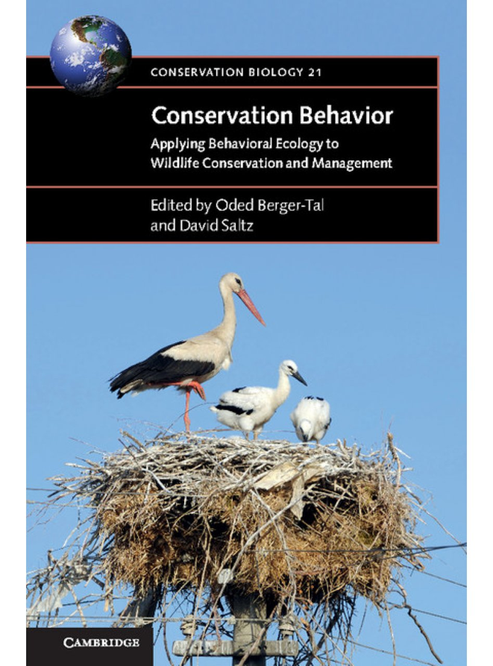
What is Conservation Behaviour?
Conservation behavior is a relatively new interdisciplinary field.
Aimed at investigating how proximate and ultimate aspects of animal behavior can be of value in preventing the loss of biodiversity.

Slide 16
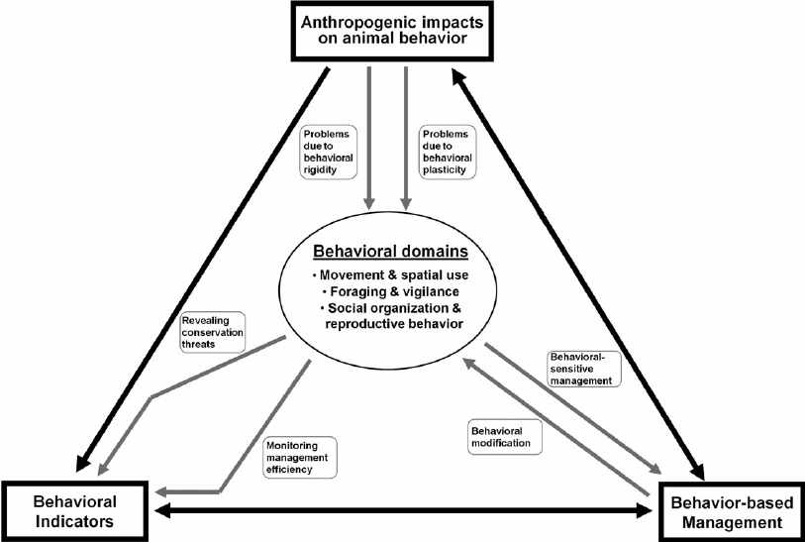
Conservation Behaviour Framework
The conservation behavior framework is composed of 3 basic interrelated conservation themes
The black arrows represent interactions between the conservation themes.
Gray arrows represent the pathways that connect each theme to the behavioral domains.

Slide 17
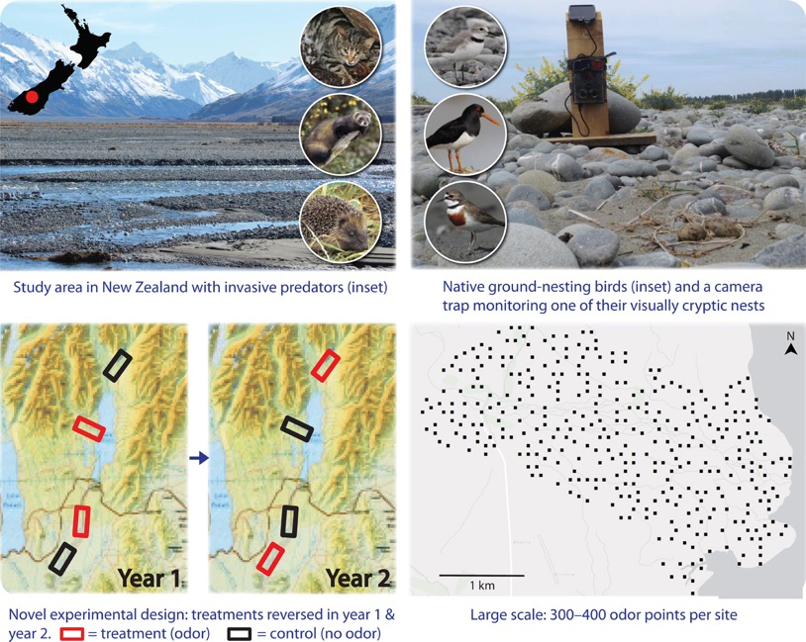
Behaviour Based management
Concept: Manipulate environments to control behaviour
Example: Predatory behaviour in NZ mammals and shorebirds
Use of aversive stimuli (unpleasant stimuli) to condition predators
Approach: Infuse Vaseline with bird odour at nest sites 5 weeks before birds arrived and 8 weeks after
Teaches predators to ignore scent as a reliable indicator of food
Outcome: Chick production increased 1.7 fold at odour treated sites
REF: Grant et al (2021). "Misinformation tactics protect rare birds from
problem predators." Science Advances 7, no. 11 (2021):

Slide 18
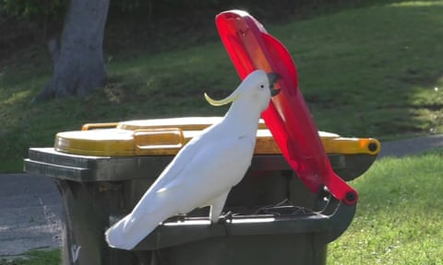
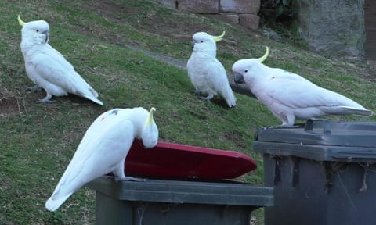
Anthropogenic impacts on animal behaviour
Concept: Behavioural plasticity causes fitness problems
Example: Foraging behaviour in Sulphur-crested cockatoos
Birds learning from each other to open lids
Cultural transmission of knowledge
Before 2018 bin opening only observed in 3 Sydney suburbs
Now spread to 44 suburbs
Problem: Sub optimal nutrition compromising bird health

Slide 19
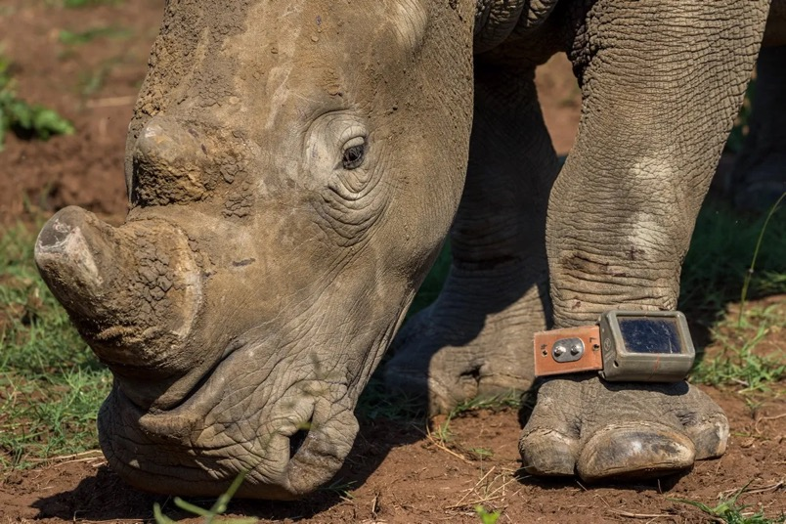
Behavioural indicators
Concept: monitoring behaviour can indicate success of a conservation action
Example: Black Rhino re-introduction in Zimbabwe
Rhinos showed progressive and consistent changes in movement patterns and habitat selection
shifting from large-scale movements during the early stages of release to smaller-scale movements after home ranges were established
REF: Wielgus, et al (2023). "Bringing the Black rhino back: Key factors for reintroduction success." Global Ecology and Conservation 48 (2023): e02756.

Slide 20
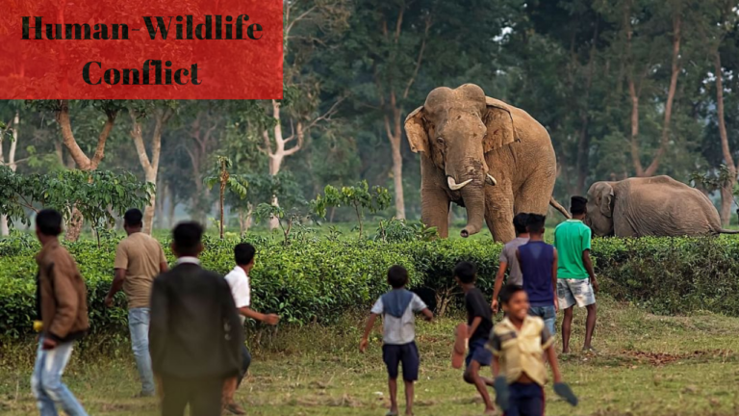
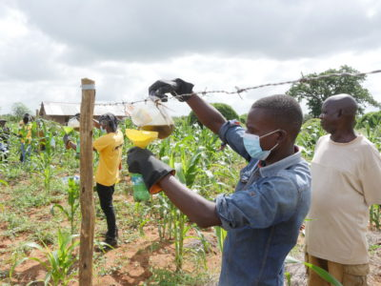
Conservation behaviour valuable for resolving Human-wildlife conflict
Human-wildlife conflict: when encounters between humans and wildlife lead to negative impacts
Conservation behaviour provides a potential solution to many conflicts
- Example: Olfactory control of elephant movement behaviour and crop damage in Kenya using repulsive odour from local ingredients
- Elephants have 2000 olfactory receptors (5 x humans)

Slide 21
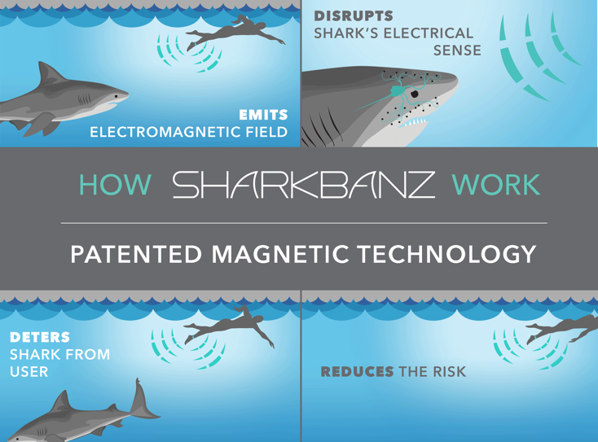
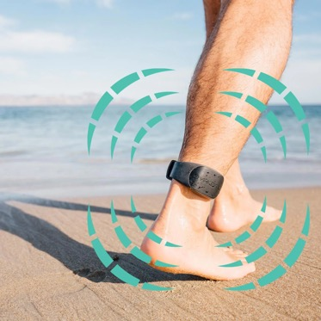
Conservation behaviour valuable for resolving Human-wildlife conflict
Encounters with dangerous species
Example: Shark deterrents
Sharks use electric signals in communication and prey detection
Research into electromagnetic shields used by ocean users

Slide 22
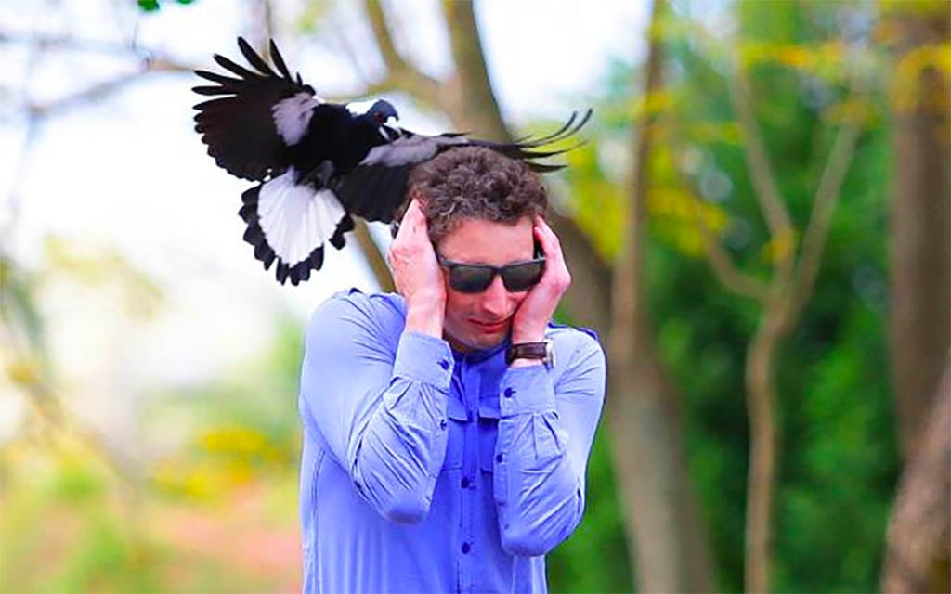
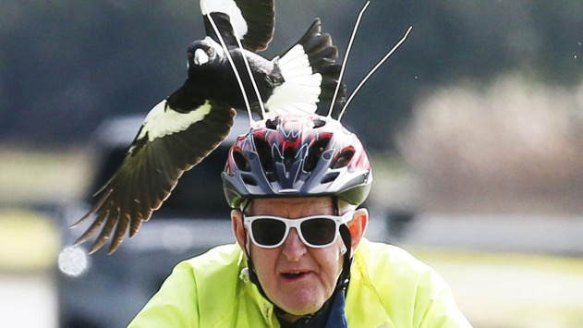
Some examples of local conflict
1. Magpie aggression
Magpies become aggressive during nesting season
Problem: attack people
Outcome: People killing magpies (biodiversity loss issue)
Cable tie deterrent makes no difference to incidence of attack

Slide 23
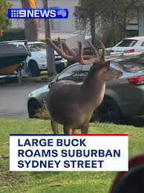
Some examples of local conflict
2. Feral deer aggression
During breeding season males become aggressive
Problem: damage property
Outcome: People killing deer (animal ethics issue)

Slide 24
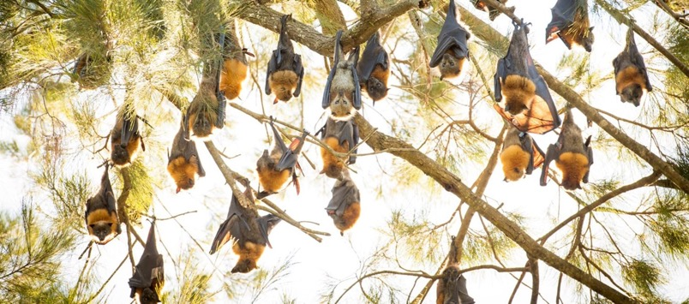
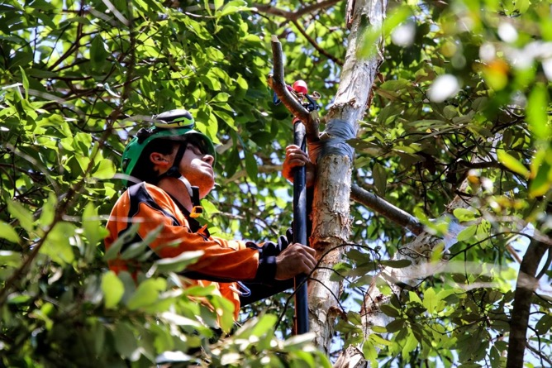
Some examples of local conflict
3. Flying foxes
Communal roosting beahviour. Roost in large camps (up to 60, 000 bats)
Problem: Nuisance species. Noise and smell disturbs residents
Outcome: People killing bats (biodiversity issue)
Bats are an important pollinator species
Councils using scare guns, smoke machines and sprinklers

Slide 25
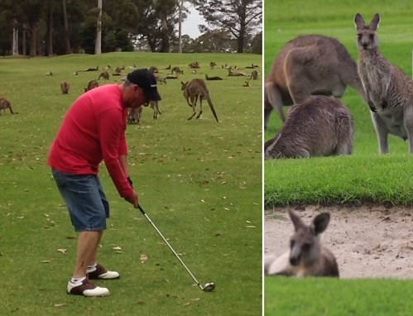
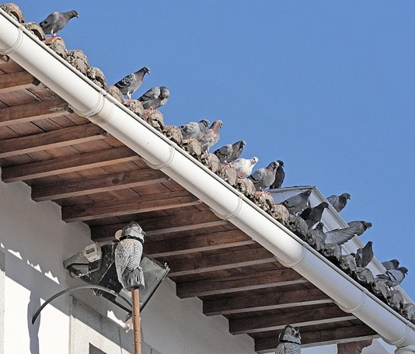
What will you be doing?
1. Activity: Spend 1-2 prac classes wandering the campus, botanic gardens or local green space.
2. Aim: to observe interactions between humans and wildlife and document a human-wildlife conflict.
-3 Assessment: Present a 5 minute ‘Elevator pitch’ to the class where you draw on principles of evolution and behavioural ecology to pitch a ‘solution focussed project’ to a funding body (e.g. Wollongong City Council, UOW).

Slide 26

What is an elevator pitch ?
An elevator pitch is a brief and succinct speech to outline your background, or your idea for a project, with the goal of drawing someone into a collaborative relationship.
It should be delivered in 5 minutes or less.
A breakdown of the components of the pitch and a marking guide will be provided in the first prac class of the module

Slide 27
What will we do in each prac class?
Week 6: Introduction to the prac and overview of the assessment and marking guide. Brainstorming session with Phil and peers. Risk assessments.
Week 8: Field work. Observation of a conflict. Take time to walk around campus, botanic gardens, beach or any local greenspace. Opportunity to meet in class to discuss ideas with Phil.
Week 9: Fieldwork and/or opportunity to meet in class to discuss observations with Phil. Opportunity to work on the elevator pitch in class.
Week 10: Presentation of the elevator pitch to the class.

Slide 28

Seminars in weeks 11 and 12
Seminars on hot topics in ecology and evolution
10 minute talk worth 20%
Half the class present in week 11
Half the class present in week 12
Topics are on moodle
- Read the description and put your name next to a topic in today’s class
If you want, you can come up with your own topic

Slide 29
Questions

